Slide 1
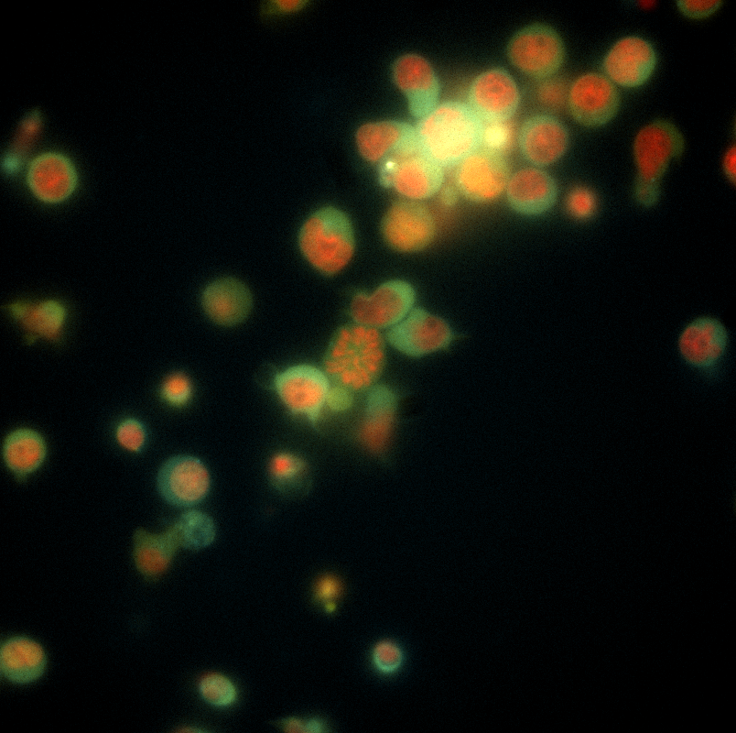
Image Processing for Microscopy
QCBio Collaboratory Workshop
Haripriya Vaidehi Narayanan
haripriyavn@ucla.edu
Nov 2022

Slide 2
GOALS OF THIS WORKSHOP
Understand how microscopy images are formed, what is a digital image, and how to work with it
Understand basic mathematical principles of common operations performed on images and image sequences
Develop a simple pipeline to quantitatively analyze objects in a given image
Become able to use online resources to follow advanced topics confidently
You WILL NOT become an expert in image processing BUT…
You WILL gain the tools to go on a self-learning journey towards expertise! 😊

Slide 3
WORKSHOP STRUCTURE & SYLLABUS
Day 1 – Basic physics, math & computational principles of image processing
Image formation, display, and storage
Spatial resolution & bit depth
Images as pixel intensity histograms
Images as matrices
Day 2 – Fundamentals of image processing pipeline development
Image filtering
Thresholding & segmentation
Day 3 – Feature extraction, quantitative analyses, and object tracking
Morphological operations
Quantifying object properties
Basics of object tracking

Slide 4
COURSEWORK & GRADING POLICIES
We will work entirely in this online Google Co-Lab notebook. This will be both your course “textbook” and “workbook”.
Each day has a take-home quiz – open-book, open-notes, open-Google-search! Fill in and email me your answer sheets before 8.30AM next morning. (Day 3 = in-class quiz)
You may NOT consult another student on the quiz questions, nor post your questions on stack-exchange, Quora, or any homework help sites.
We will discuss the answers in class the next day. Minimum score in this course can be 50%!! For every question you get wrong, if you submit another answer sheet writing down WHY your answer was wrong, you will get half-credit!
Grading is on an absolute scale. <40% = fail, 40-55% = D, 55-70% = C, 70-85% = B, >85% = A.

Slide 5
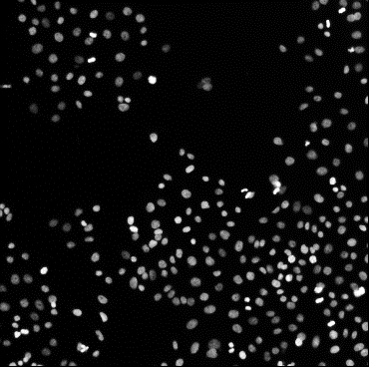
WHY DO WE NEED IMAGE PROCESSING?
After all, couldn’t we just do it all by hand?!
Take a look at the following image of nuclei within a bunch of cells. Say, you want to get size & brightness of each nucleus, to determine if it’s dividing or not!
Think about how you’d manually complete the tasks of –
counting the number of nuclei,
measuring the area of each nucleus, and
measuring the corresponding brightness.
Then consider a video where you’re trying to see how these parameters are changing over time.
What challenges can you foresee in this task?

Slide 6
WHY DO WE NEED IMAGE PROCESSING?
Manual processing is highly variable, cumbersome, and time-consuming
Images are now a form of multi-dimensional big data! We can collect terabytes (1TB = 1M MB) per experiment!!
Hence, automation is required for consistency and throughput.
The challenge of image processing is that each problem can be unique, requiring tailor-made pipelines depending on its particular features.
Therefore, it’s important to understand the fundamental principles and use them contextually, rather than applying formulaic plug-and-play pipelines.

Slide 7
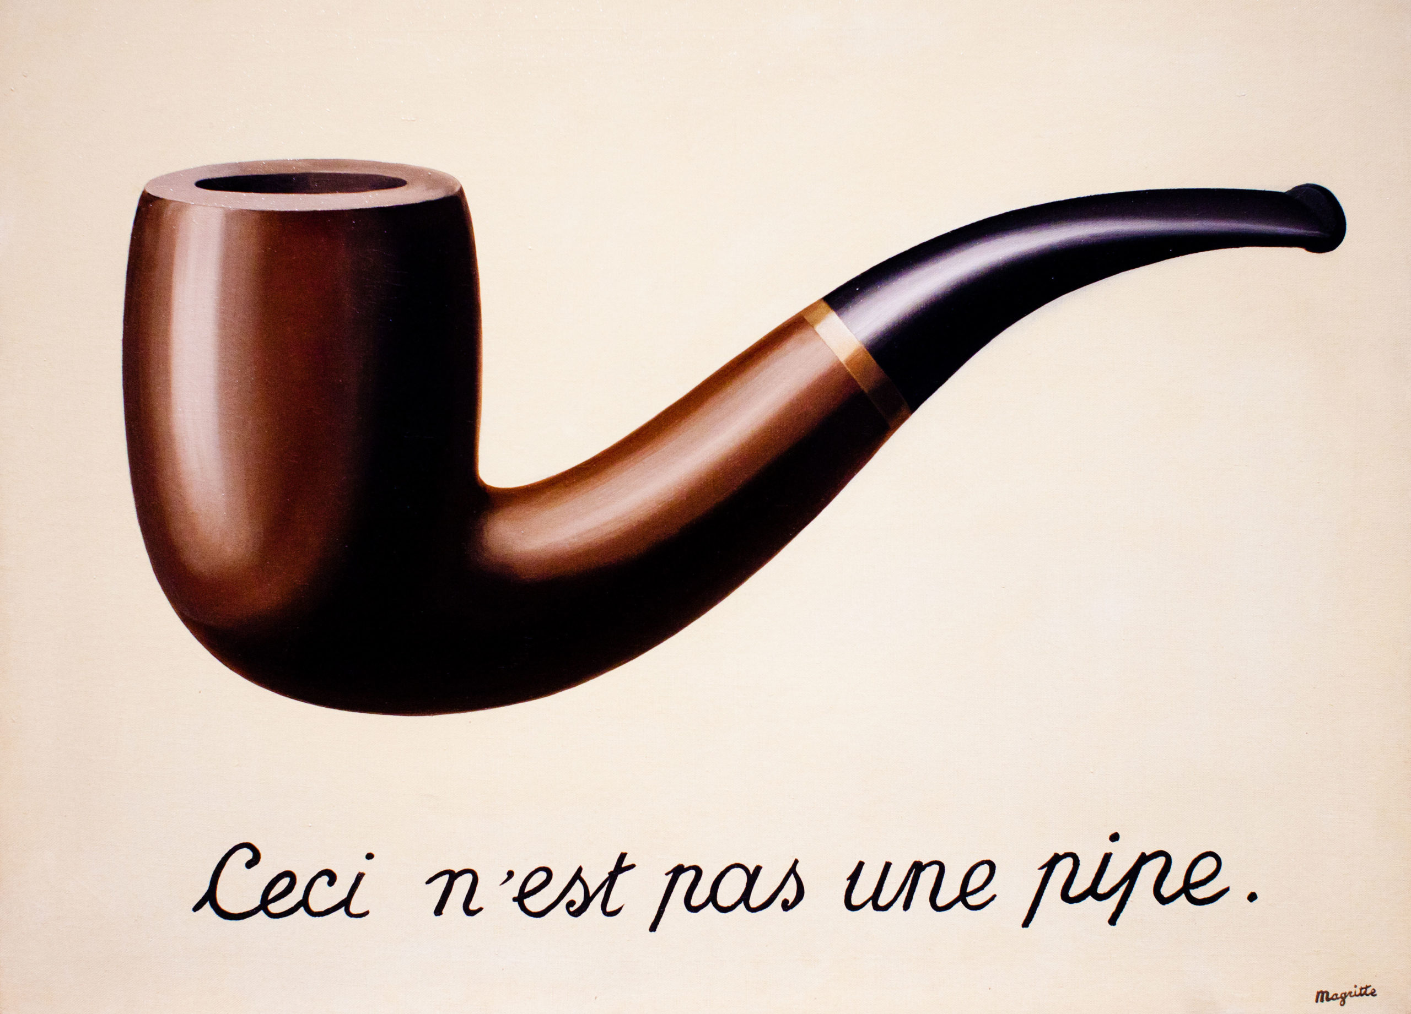

WHY DO WE NEED IMAGE PROCESSING?
line
We need to know what’s available in the toolbox, and what the different tools do

Slide 8


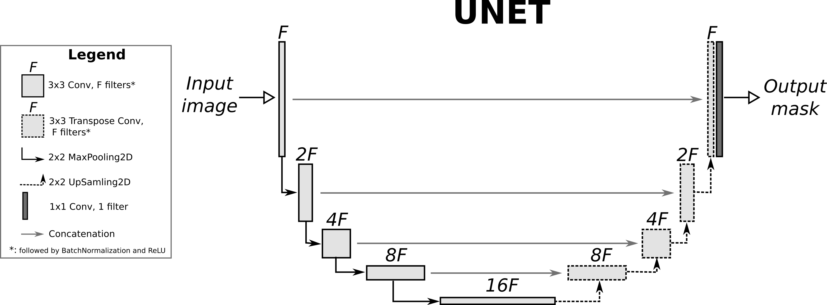

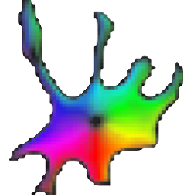
MANY TOOLS AVAILABLE FOR IMAGE PROCESSING
There are numerous off-the-shelf tools which you MUST explore (on your own…)
Here, we will learn what’s happening beneath the hood in the functions provided by these tools, so that you can choose which operations to use or parameters to tweak.
cellpose

Slide 9
SOME MORE LEARNING RESOURCES (AMONG MANY OTHERS…)
iBiology Bioimage Analysis Course: The Life Cycle of an Image Data Set – https://www.ibiology.org/online-biology-courses/bioimage-analysis-course/
Introduction to Bioimage Analysis by Pete Bankhead – (my personal favourite) https://bioimagebook.github.io/README.html
Bioimage analysis notebooks by Robert Haase – https://haesleinhuepf.github.io/BioImageAnalysisNotebooks/intro.html YouTube lectures - https://www.youtube.com/playlist?list=PL5ESQNfM5lc7SAMstEu082ivW4BDMvd0U
FIJI YouTube tutorials – https://www.youtube.com/playlist?list=PL5Edc1v41fyCLFZbBCLo41zFO-_cXBfAb
CellProfiler YouTube workshops – https://www.youtube.com/playlist?list=PLXSm9cHbSZBCfLa3KAgMcndCXQvJluEtF
University of Geneva Bioimaging core : list of online courses / resources – https://www.unige.ch/medecine/bioimaging/en/information/tutorials-1/online-courses/

Slide 10
PACKAGES USED IN THIS WORKSHOP
Fiji for GUI : Download from Fiji.sc
Python Co-lab for notebooks
numpy for arrays
matplotlib for plotting graphs & displaying images (image, pyplot)
scikit-image for command line image analysis : Read the API documentation here
scikit-image is structured as a set of sub-packages or modules, which must be individually imported to use in your pipeline. The main modules we’ll use are – * color * data * exposure * feature * filters
* measure * morphology * transform * util
Let us start by making sure we have all of these packages installed and working!

Slide 11
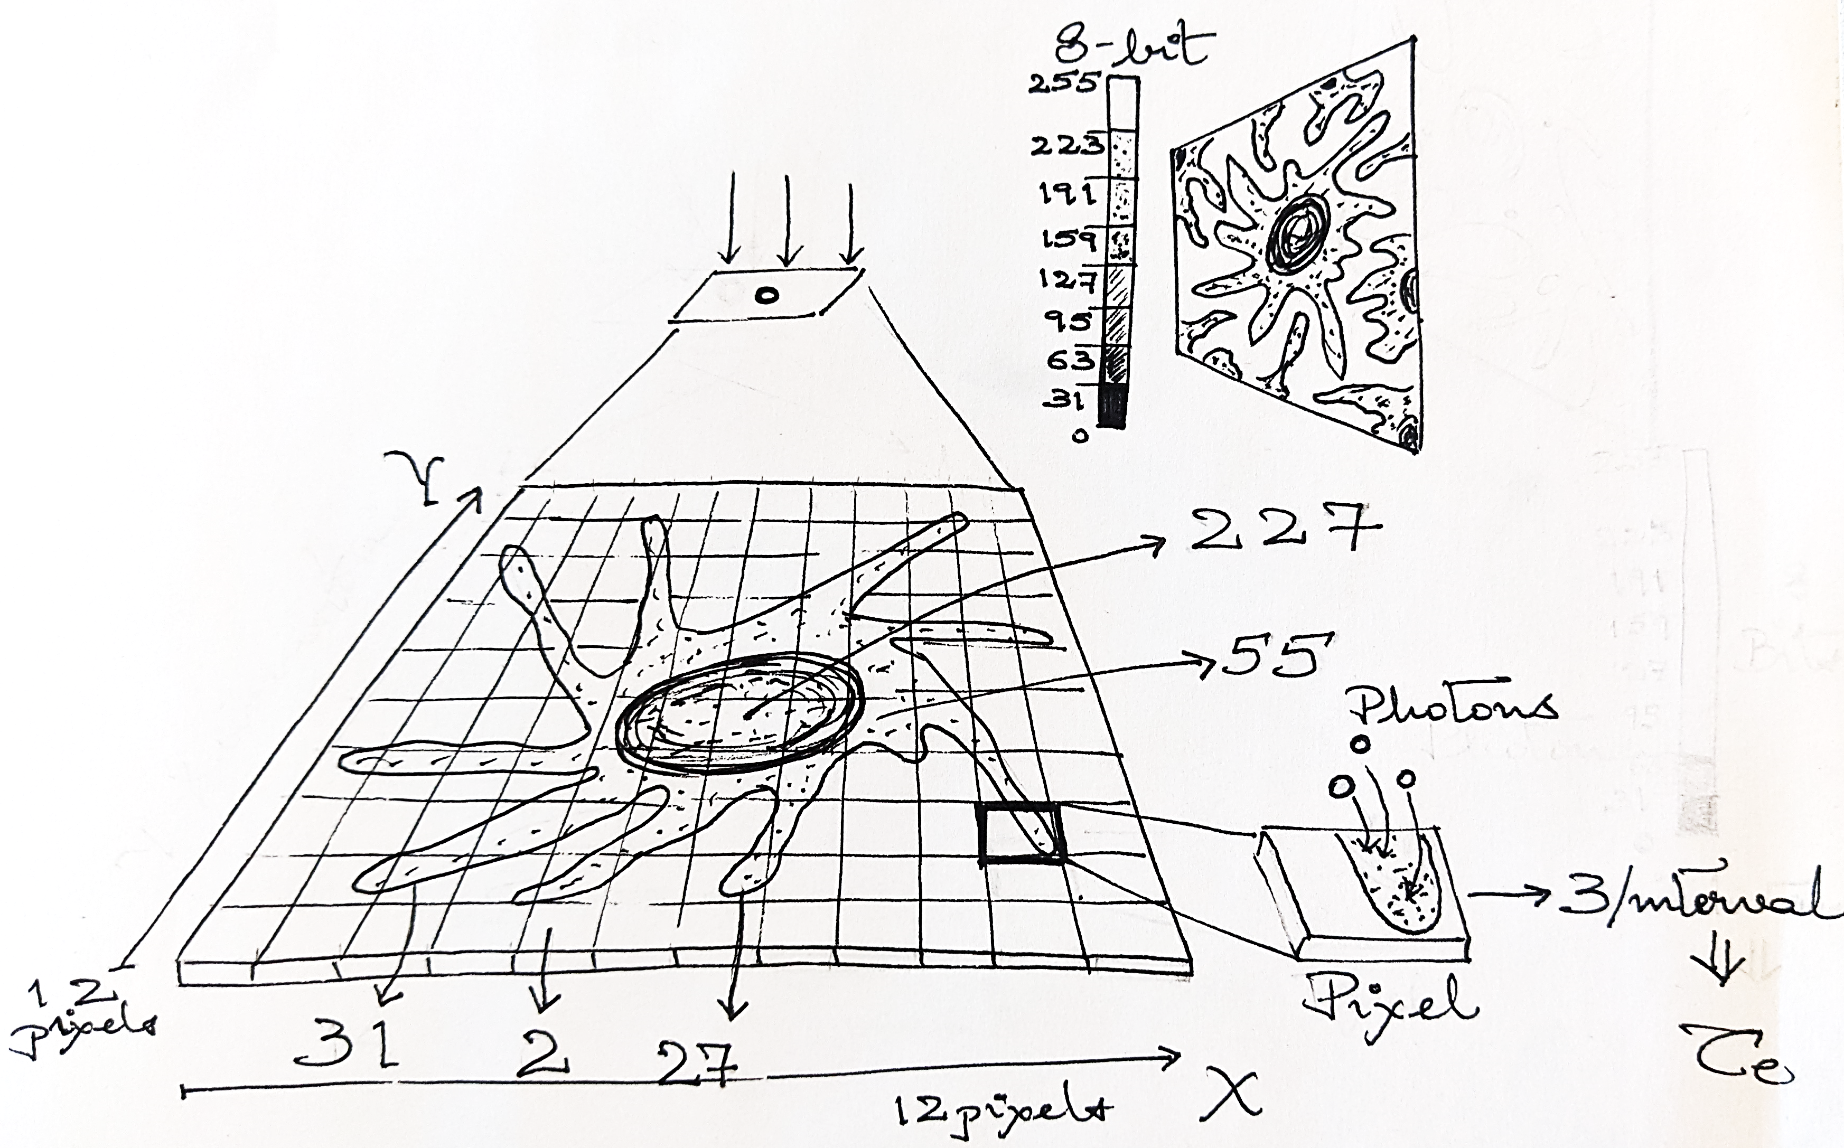
HOW IS AN IMAGE FORMED AND DIGITIZED?

Slide 12
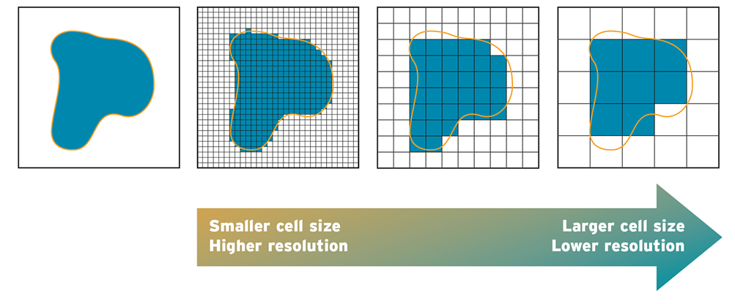
SPATIAL RESOLUTION OF AN IMAGE
pixel
pixel
Pixel size is a built-in physical property of the camera
We cannot measure spatial structures smaller than a single pixel!
Binning pixels reduces random noise at the expense of resolution

Slide 13
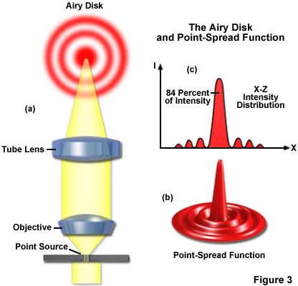
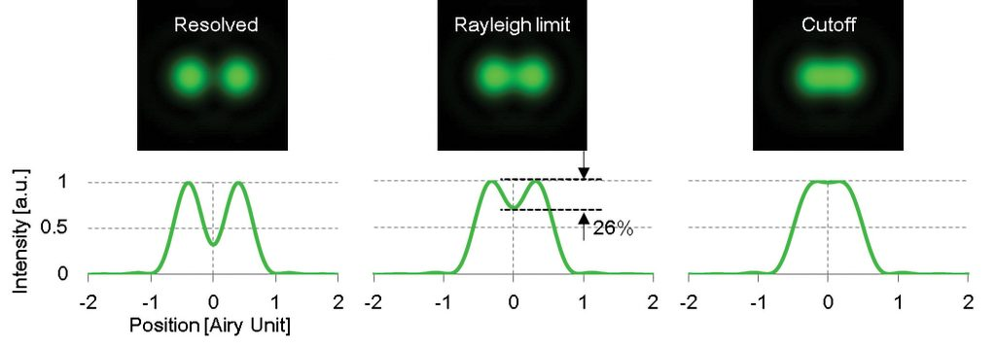
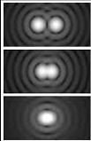

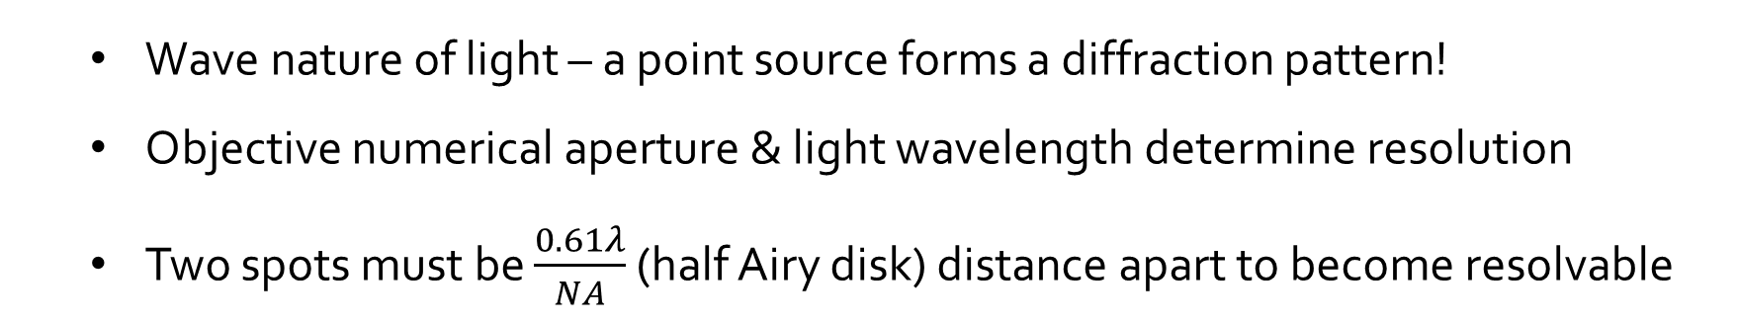
POINT SPREAD FUNCTION
$$\frac{0.61λ}{NA}$$
Zeiss Online Campus
Edinburgh Instruments
Teledyne Photometrics
Wave nature of light – a point source forms a diffraction pattern!
Objective numerical aperture & light wavelength determine resolution
Two spots must be $\frac{0.61λ}{NA}$ (half Airy disk) distance apart to become resolvable

Slide 14
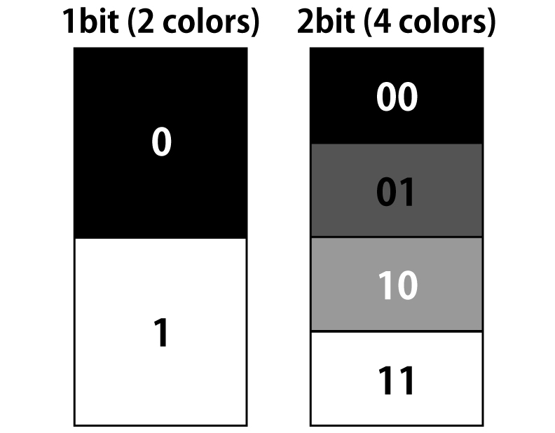
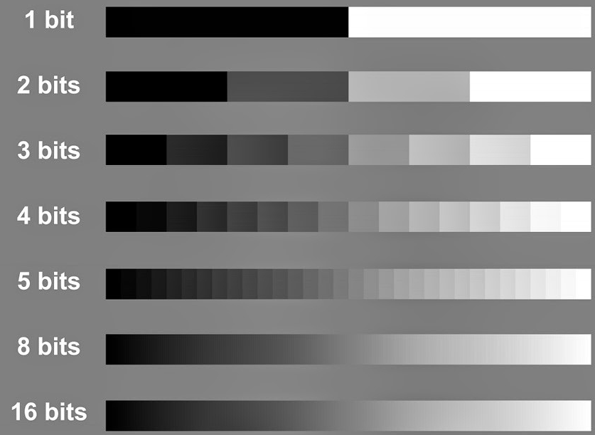
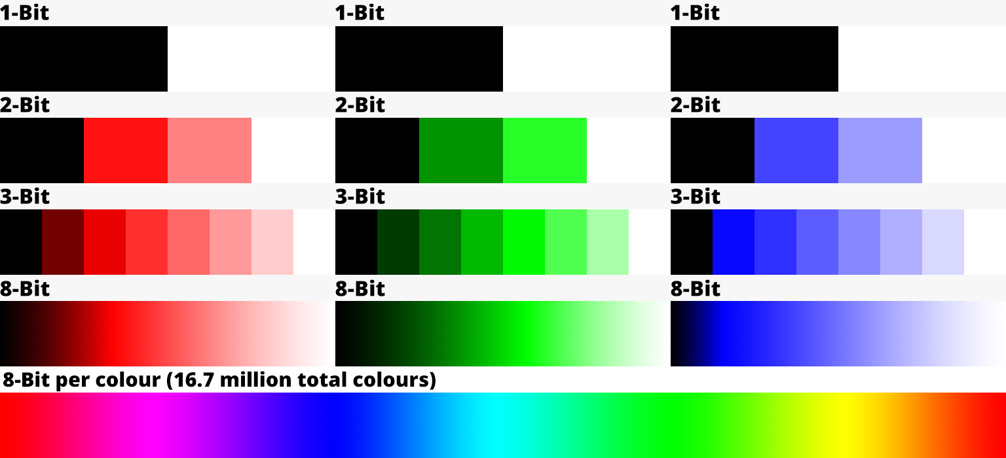
BIT-DEPTH OF AN IMAGE
Teledyne Lumenera
Silkypix
Number of levels for intensity resolution of an image
Bit depth can be downsampled (although info is lost)
Bit depth cannot be upsampled (needs interpolation)
DIY Photography

Slide 15
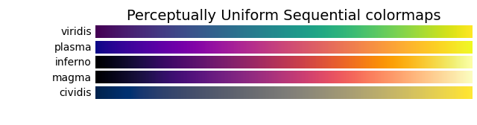
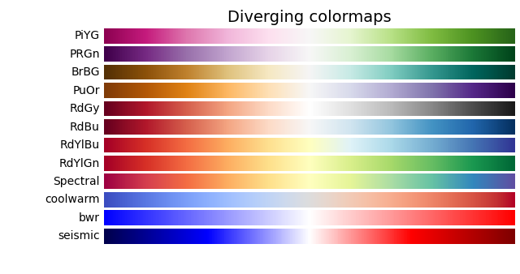
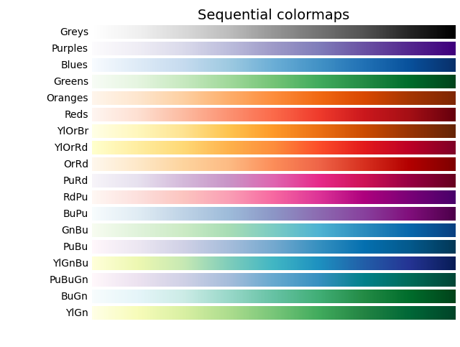
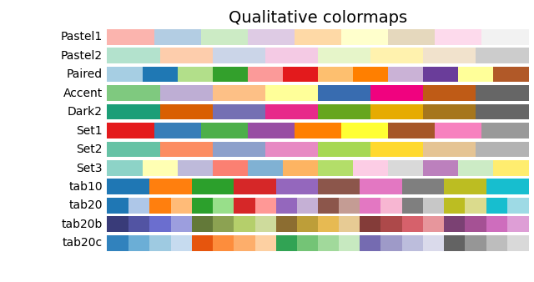
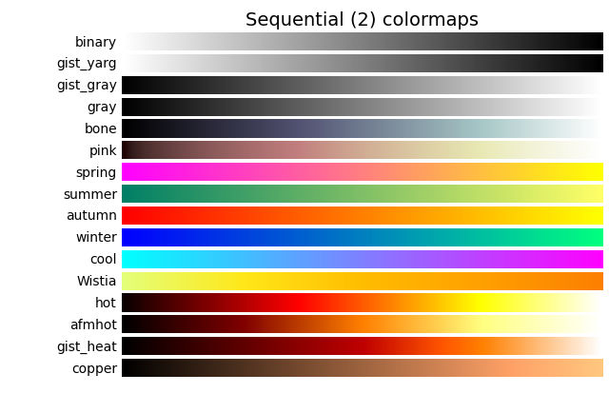
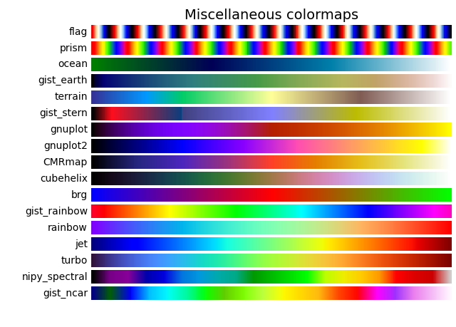

LOOK UP TABLES & IMAGE DISPLAY

Slide 16
COMPRESSION, DATA STORAGE & FILE TYPES
Imaging data has 2 components –
The imaging data (pixel values)
The metadata
Pixels to micron conversion scale
Dimensions
Bit-depth
Pixel size (physical dimensions of each pixel on camera)
Objective properties …etc etc
OME-TIFF format (Open Microscopy Environment) tries to standardize metadata

Slide 17
COMPRESSION, DATA STORAGE & FILE TYPES
Uncompressed data –
Preserves all pixel values and metadata
Only option for accurate quantitative analysis
You MUST retain your raw uncompressed files until (& ideally also after) publication of your manuscript!
Generally comes in proprietary file formats –
CZI (Zeiss), ND2 (Nikon), LIF (Leica), OIB (Olympus)
Can be opened by BioFormats plugins (Fiji, Napari for Python)
Can be saved as TIFF files – best file type option for export and analysis

Slide 18
COMPRESSION, DATA STORAGE & FILE TYPES
Loss-less compression –
Less reduction in file size
However, all original data can be reconstructed ; very practical!!
Good for display in publications, presentations, etc
Commonly used file formats –
* PNG * BMP * TIFF (LZW compression)
When you get a TIFF file – Note that it could be compressed or not, and check before analyzing!!
You can also make ZIP archives for lossless compression

Slide 19
COMPRESSION, DATA STORAGE & FILE TYPES
Lossy compression –
More reduction in file size, but at the cost of data quality!
Some original data may be permanently lost
Commonly used file formats * JPEG * GIF
Good for display in websites, thumbnails
Otherwise, AVOID JPEG LIKE YOUR WORST ENEMY
Once you compress a file with loss, you cannot re-save it in a different format and expect to regain the data – ”what is lost is forever gone”!!
NEVER analyze lossy compressed files – pixel values cannot be trusted

Slide 20
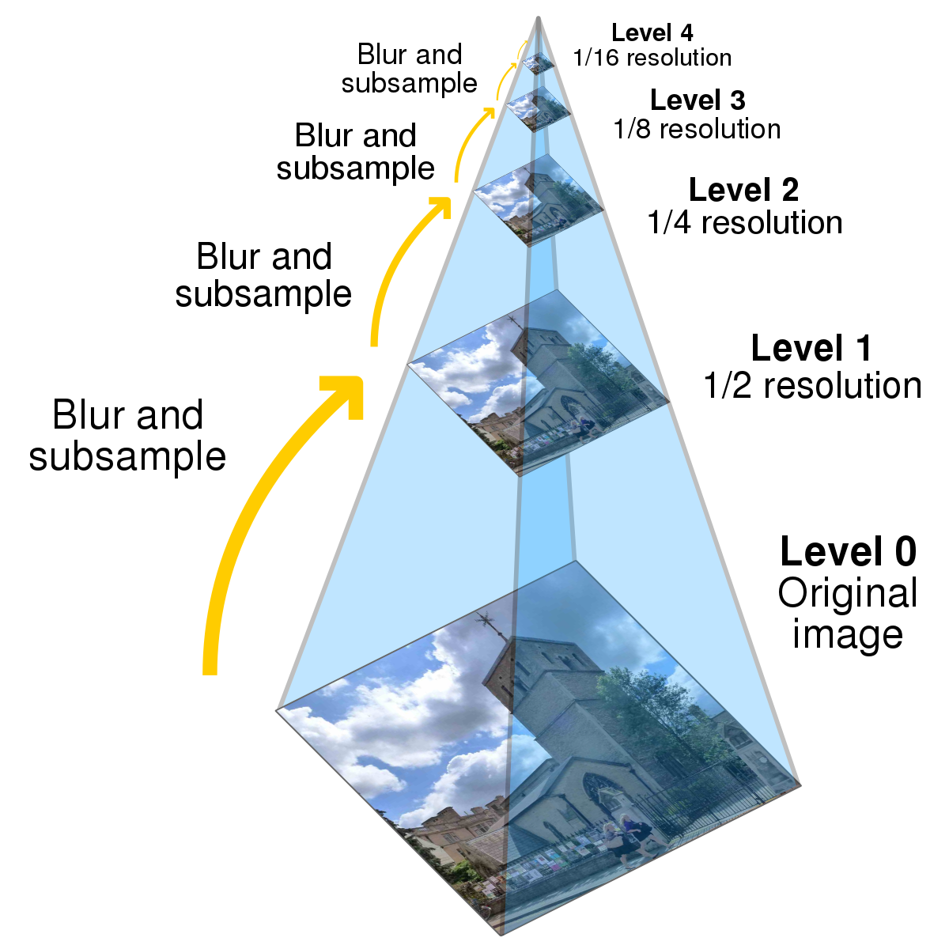
COMPRESSION, DATA STORAGE & FILE TYPES
Image pyramid -
Technique to speed up display across various zooms
Used for full slide scans, region tiling, etc
Stores multiple versions of the image at different spatial resolutions
Wikipedia

Slide 21
COMPRESSION, DATA STORAGE & FILE TYPES
How can we calculate file size of an image (sequence) in memory ?
Bit depth = number of bits required to store 1 pixel
Dimensions X * Y = total number of pixels in 1 image
Channels = number of images in 1 composite frame
Bit-depth * Dimensions * Channels * Frames = Total #bits required
8 bits = 1 byte 1024 bytes = 1 kB (not 1000 bytes!)
1024 kB = 1 MB
1024 MB = 1 GB

Slide 22
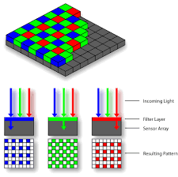
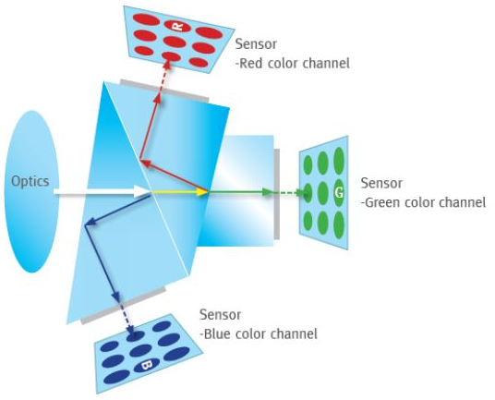
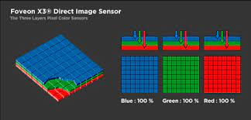
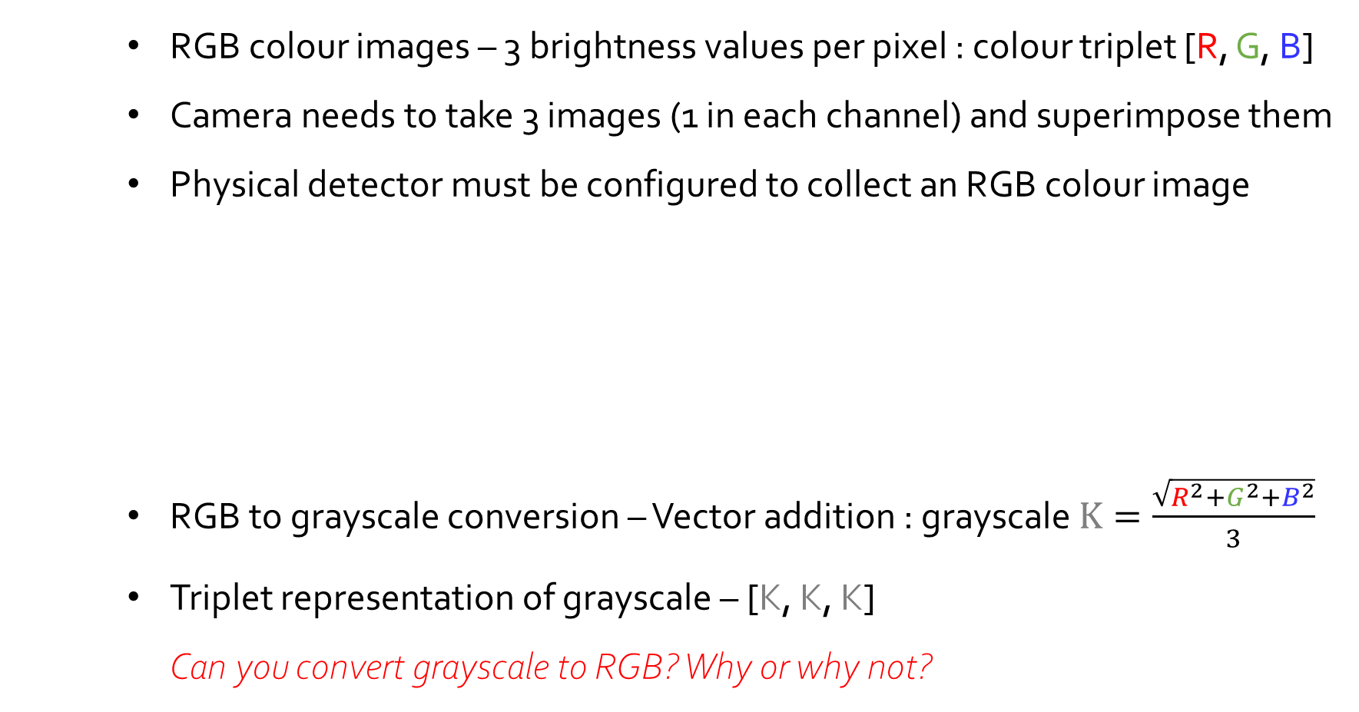
INCREASING DIMENSIONS : RGB COLOUR IMAGES
RGB colour images – 3 brightness values per pixel : colour triplet [R, G, B]
Camera needs to take 3 images (1 in each channel) and superimpose them
Physical detector must be configured to collect an RGB colour image
RGB to grayscale conversion – Vector addition : grayscale $K=\frac{\sqrt{R^{2}+G^{2}+B^{2}}}{3}$
Triplet representation of grayscale – [K, K, K] Can you convert grayscale to RGB? Why or why not?

Slide 23
INCREASING DIMENSIONS : VIDEO DATA
Video data is simply a sequence of images separated by intervals of time
Video data is 4D – X, Y, intensity, time (higher-D depending on # of channels)
Frame rate – number of images collected per unit time
Important for measuring dynamical information (eg. object speed)
Playback speed – number of images displayed per unit time This can be anything you like – sped up or slowed down – which makes the phenomena in the video look interesting
Video processing is often simply image processing for each frame
Tracking : connecting objects across frames (we will look at this on Day 3)

Slide 24
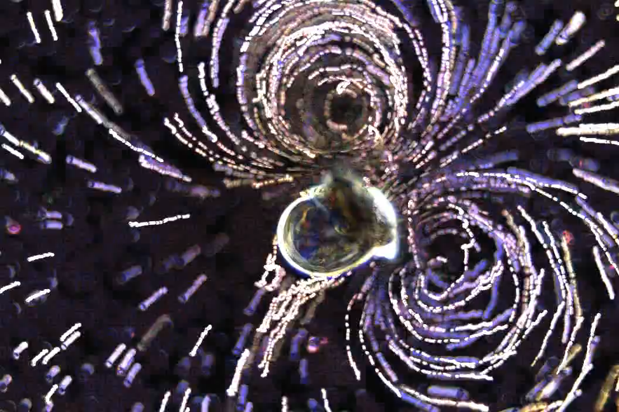
SIMPLE OPERATIONS ON VIDEO DATA
Temporal localization using sliding window
Flattening with Z-stack projection
Feeding currents of a Veliger snail larva.
Video credits : William Gilpin Flowtrace : Gilpin W, Prakash VN & Prakash M, JEB (2016).

Slide 25
IMAGE HISTOGRAMS : STATISTICAL OPERATIONS
Intensity values of an image can be represented as a frequency distribution
Binned pixel value distribution – histogram of the image We can perform statistical operations on the pixel intensity histogram!

Slide 26
BINARY IMAGES : LOGICAL OPERATIONS
Binary images are a special case of grayscale with bit depth = 1
Each pixel takes only values 0 or 1
Can be interpreted as FALSE vs TRUE – Boolean logic i.e. Can apply AND, OR, NOT, NAND, XOR gates to/between binary images!
Grayscale to binary conversion – Cutoff between 0 & 1 is called threshold
Also called binary masks – can be used to isolate a specific part of an image
Put image here showing 8-bit vs 1-bit

Slide 27
IMAGES AS MATRICES : POINT OPERATIONS
Images are comprised of intensity values tied to spatial locations Scrambling example shows how important the spatial location is
Mathematical representation of images = 2-D row-column matrix Hence, all matrix operations are possible!

Slide 28
MATRIX TRANSFORMATIONS IN X-Y-Z
Affine transformations – preserve collinearity of points along a line
Scaling
Translation
Rotation
Skew

Slide 29
MATRIX TRANSFORMATIONS IN X-Y-Z
Non-affine transformations – do not preserve collinearity of points
Eg. Warping, sweeping along a path, projections

Slide 30
IMAGE REGISTRATION
Transforming image matrices to align on same absolute coordinate system
Apply affine transforms through matrix multiplication
Minimize distance between fiduciary markers
Reverse engineer the transformations that differentiate the two images

Slide 31
IMAGE FILTERING
Filtering – applying a small matrix operation to each pixel of an image
Small matrix = Kernel of the filter
Application of the kernel = Convolution with the filter
Filters enhance the features in an image and reduce noise Noise = random Gaussian variations in pixel intensity
Linear filters – linear combination of pixels (Mean, Gaussian, etc)
Non-linear filters – non-linear combinations of pixels (Rank & edge filters) Cannot recreate original image after non-linear filtering!! Always keep a copy of the original, and work on a duplicate image

Slide 32
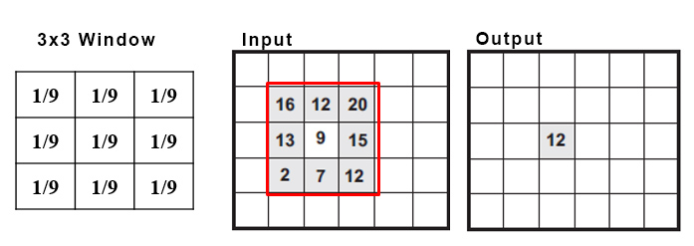
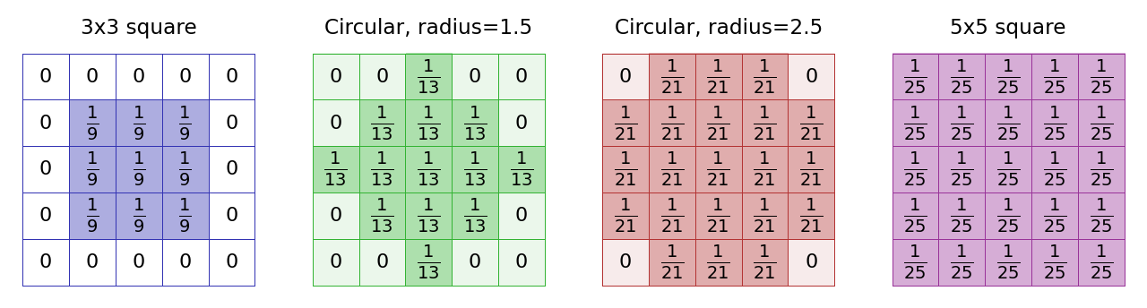
IMAGE FILTERING
Mean filters –

Slide 33
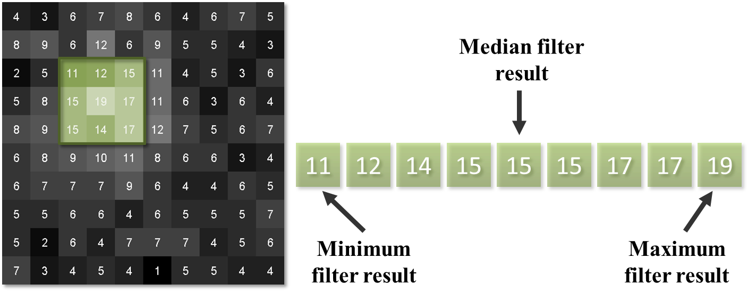
IMAGE FILTERING
Rank filters –

Slide 34
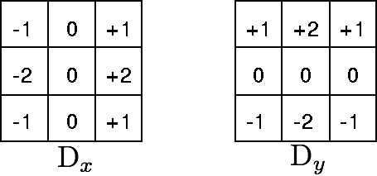
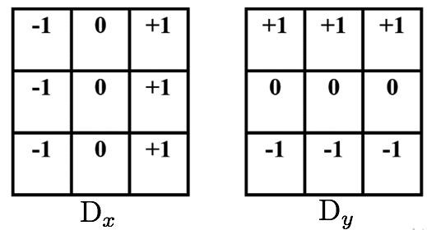
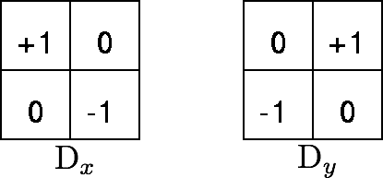
IMAGE FILTERING
Sobel filters –
Prewitt filters –
Roberts cross operator –

Slide 35
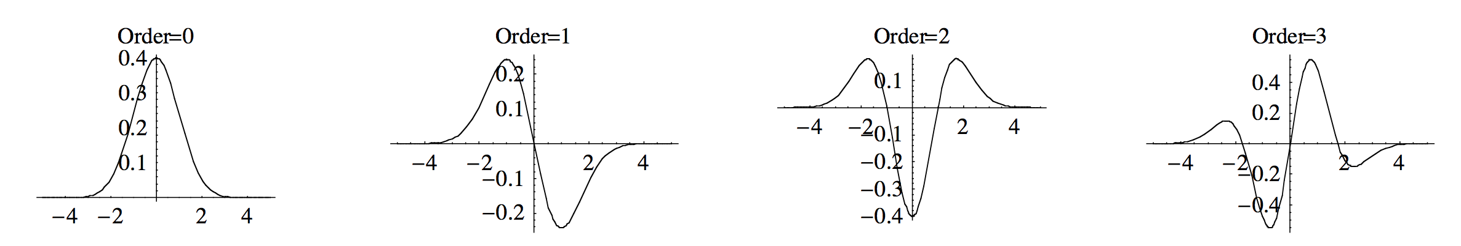
IMAGE FILTERING
Gaussian filters & their derivatives –
Gaussian
Laplacian of Gaussian (LoG)

Slide 36
THRESHOLDING & SEGMENTATION
Recall – Thresholding creates binary images by deciding on a cutoff value
Thresholding separates foreground from background of an image
Global thresholding vs local thresholding
Segmentation = separating individual objects in an image
Automated segmentation avoids biases from manual segmentation
The choice of threshold value is very important (but often not perfect!)
Too high threshold = object size reduced, some objects lost
Too low threshold = object size increased, some objects merged
Different thresholding algorithms suit different histogram distributions

Slide 37
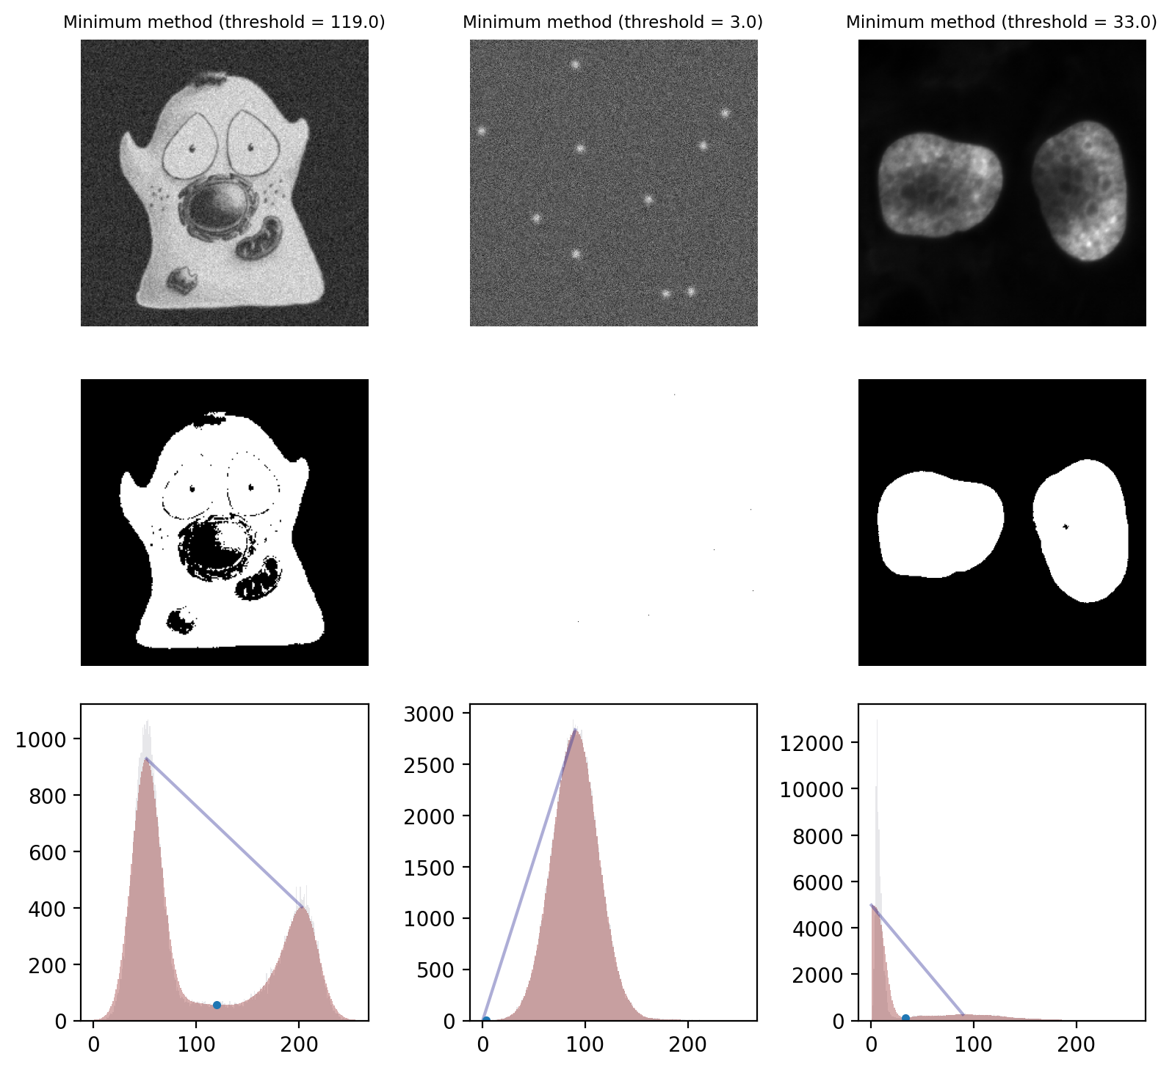
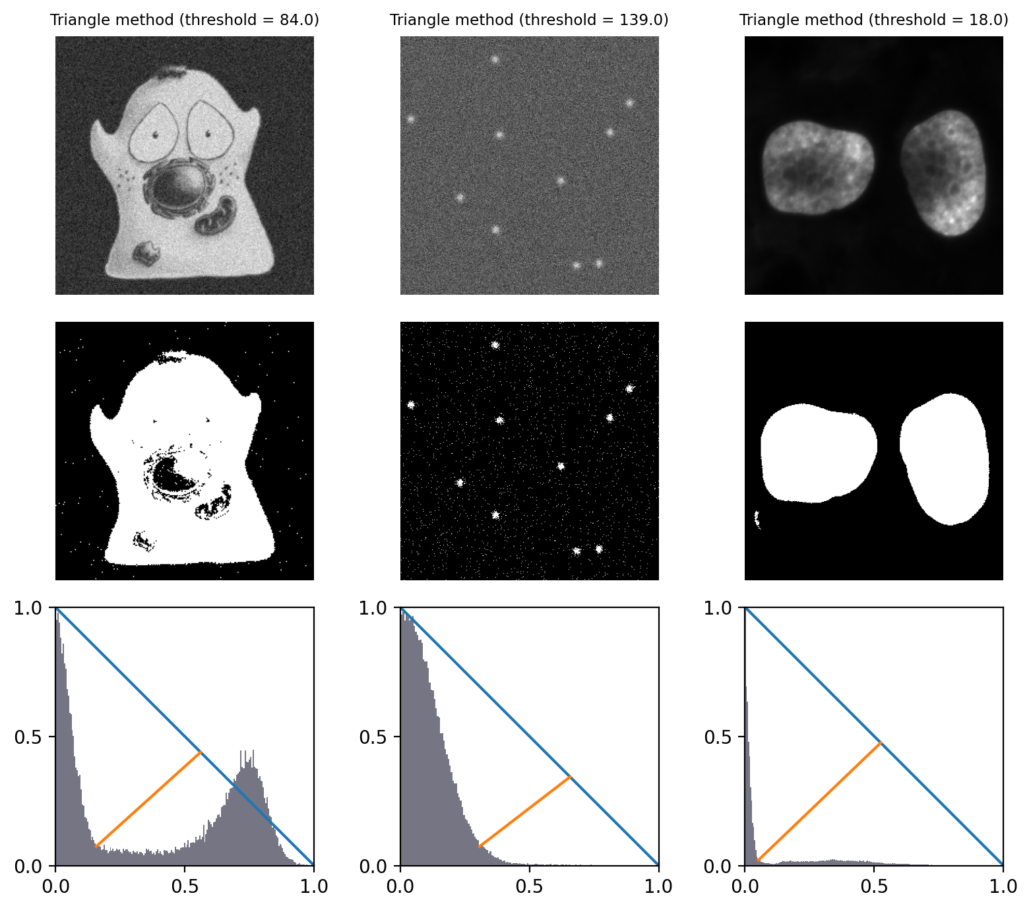
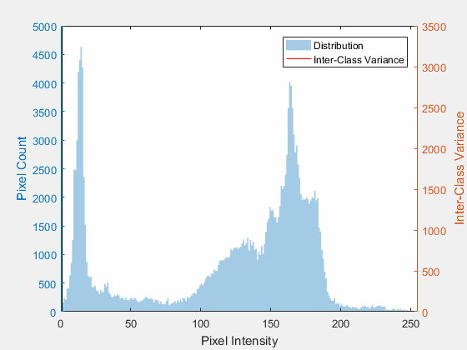
THRESHOLDING & SEGMENTATION
Recall – Thresholding creates binary images by deciding on a cutoff value
Thresholding separates foreground from background of an image
Global thresholding vs local thresholding
Segmentation = separating individual objects in an image
Here is some theory for four different thresholding algorithms –
Mean thresholding – simple pixel average, you may get lucky!
Minimum – best for bimodal histograms (may fail to converge!)
Triangle – best for eliminating a dominant background with low signal
Otsu – best for separating bimodal histogram with deep valley
Minimum
Triangle
Otsu

Slide 38
MORPHOLOGICAL OPERATIONS
Connected components – contiguous areas of bright pixels in binary image
4-connected (1-connectivity) = top, bottom, and sides only
8-connected (2-connectivity) = allows connection along diagonal neighbours
Segmentation yields a binary mask with connected components
Inaccuracies – components may either overlap or be broken up
Morphological operations allow us to adjust connected components
Structural element (strel) – “kernel” for morphological operations
1-connectivity 2-connectivity
[ ] [ ] [ ] [ ]
| \ | /
[ ]--[x]--[ ] [ ]--[x]--[ ]
| / | \
[ ] [ ] [ ] [ ]

Slide 39
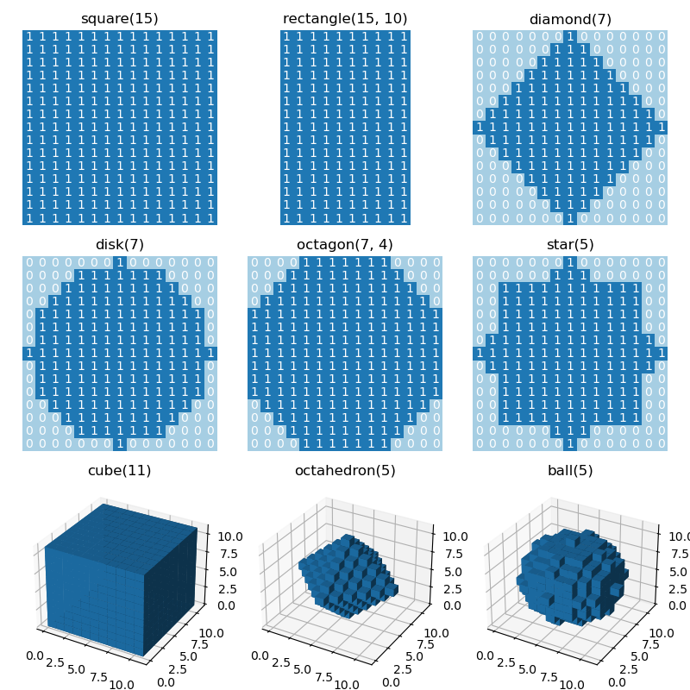
MORPHOLOGICAL OPERATIONS
Structural element (strel) – “kernel” for morphological operations

Slide 40
MORPHOLOGICAL OPERATIONS
Erosion = min-filter with strel kernel, reduces bright areas
Dilation = max-filter with strel-kernel, expands bright areas Erosion & dilation may preserve neither areas nor # of CCs
Opening = Erosion then dilation (same strel), disconnects CCs
Closing = Dilation then erosion (same strel), merges CCs Opening & closing approximately preserve areas while changing # of CCs
Area opening / remove bright spots
Area closing / fill small holes
Edge finding – inner vs outer boundaries
Convex hull & skeletonization

Slide 41
FEATURE EXTRACTION & OBJECT PROPERTIES
Each connected component is labeled with an index number
Background gets the index 0
Properties –
Area
Centroid
Eccentricity
Intensity_max, intensity_image
Perimeter
Solidity … etc etc

Slide 42
SIMPLE INTRO TO OBJECT TRACKING

